Slide 1



Data Entry & Inquiries
(RTW)
USER GUIDE

Slide 2
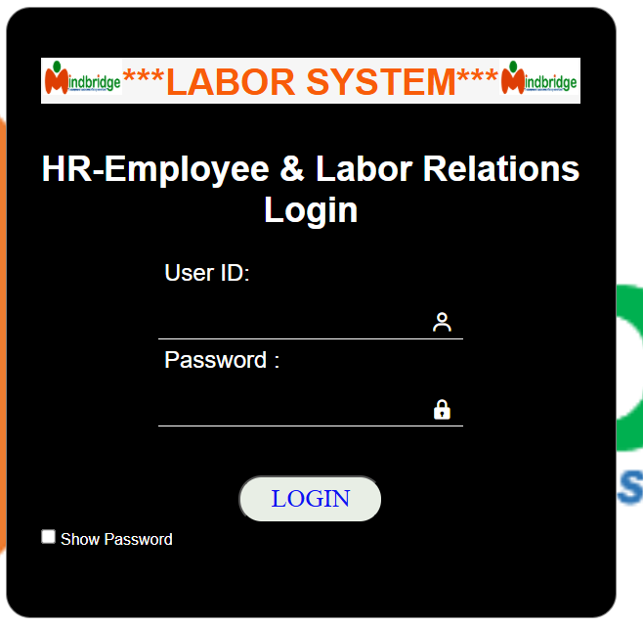
Logging into Labor System
Once the user(s) received the User ID & Password details, click / type the given URL link provided and you will be taken to the log in page screen.

Slide 3
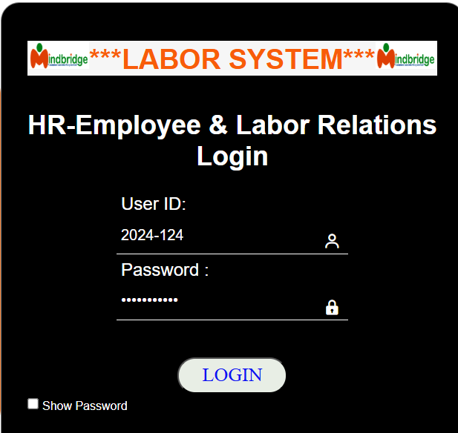
Navigate to the Labor Systems login page.
  Enter your User ID (Username) in the corresponding field.
  Enter your Password in the password field.
  Click the LOGIN button.
Please note: You should follow your company security policy advice.

Slide 4
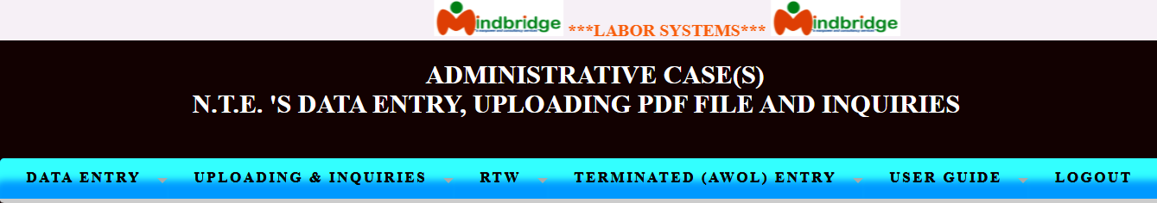
CONTENTS TREE
When you open a Labor Systems (LS), a contents tree will be displayed to the botton of the main screen.
The Contents tree will include a list of all Input statements that are available to you in this Data Entry Module and Reports & Inquiries.
The main window has the menu bar with the following options: DATA ENTRY, UPLOADING & INQUIRIES, RTW, TERMINATED (AWOL) ENTRY, USER GUIDE and LOGOUT.

Slide 5
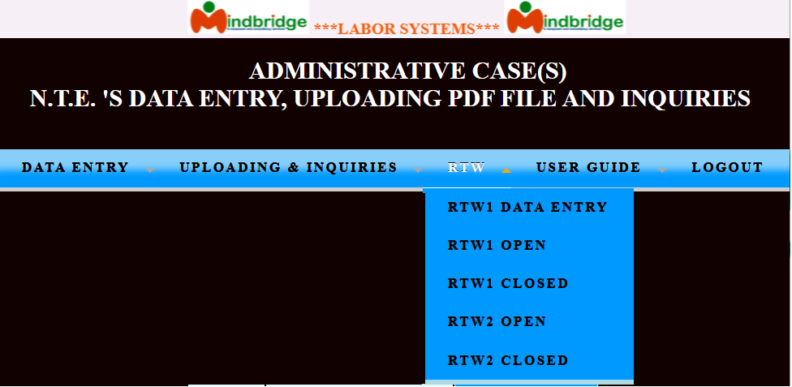
RTW (Return To Work)
A "Return to Work" notice is a formal communication from an employer to an employee, requiring them to resume their job duties.
* Accessing RTW -To access the RTW section, go to the main window. Click on RTW menu bar, then choose the criteria appears as shown below. The Labor Systems (LS) user(s) can view only the criteria base on their user LOGIN.
On selecting the “RTW” option on the menu-bar of the main window, a pull-down menu is displayed.
* RTW1 DATA ENTRY- Where to encode the first Return to work notice of the Employee.
RTW1 (Return To Work1)
An RTW1 (Initial Notice), or Return to Work 1 Order, acts as a formal communication from an employer to an employee who has been absent without approved leave (AWOL). A warning that failure to report back or respond in 48 hours may lead to disciplinary action, including termination for abandonment of work.

Slide 6
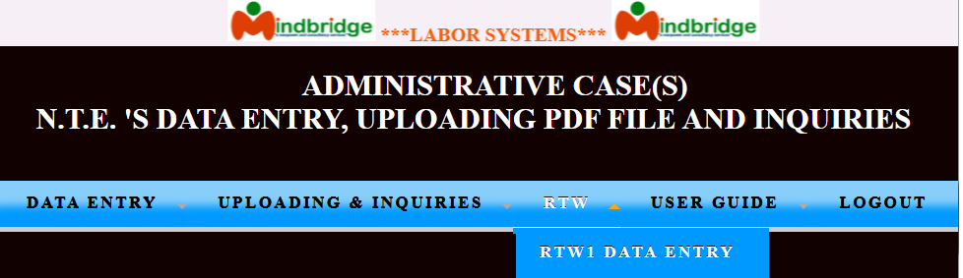
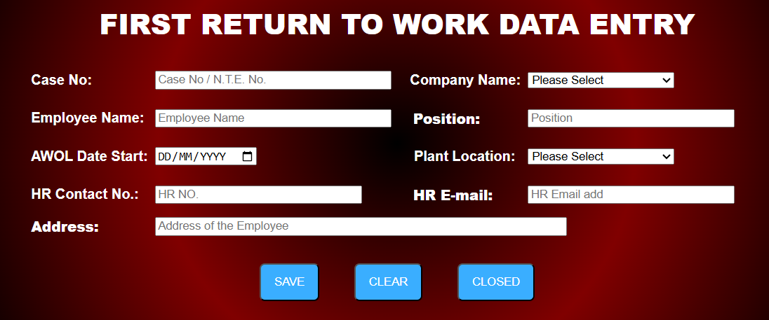
Toggle mouse/cursor to the RTW
=> RTW1 DATA ENTRY
On selecting the “RTW1 DATA ENTRY” option, the Information window screen is displayed. Given in the next window is a sample display of the RTW1 DATA ENTRY control information window.
Fill in all fields based on the documents handled.

Slide 7
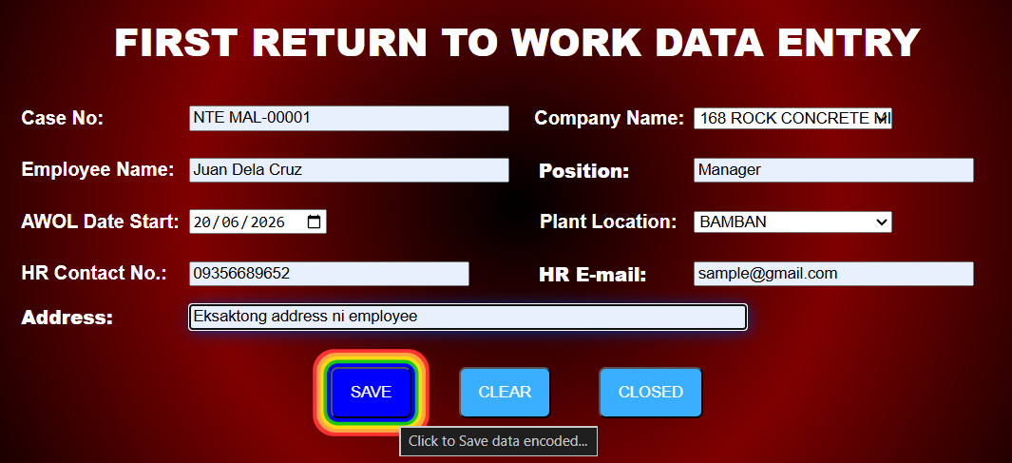
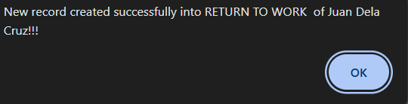
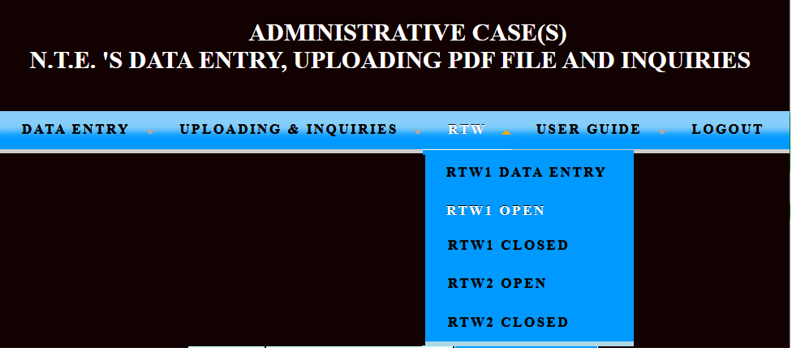
Always review the encoded data to ensure all data is correctly populated before finalizing, and saving. After ensuring all required fields are correctly completed, the data is saved by selecting the "SAVE" button and a pop message window is displayed.
Click “OK” to return to Data Entry screen
RTW1 OPEN
Toggle mouse/cursor to the RTW
=> RTW1 OPEN = Usually only becomes active after the user(s) encoded Return to Work 1 (RTW1) into the system. Just refresh the menu bar always.
On selecting the “RTW1 OPEN” option, all the information encoded will displayed / show on the window screen. Given below is a sample display of the RTW1 OPEN control information window.

Slide 8
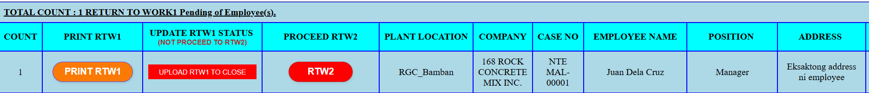
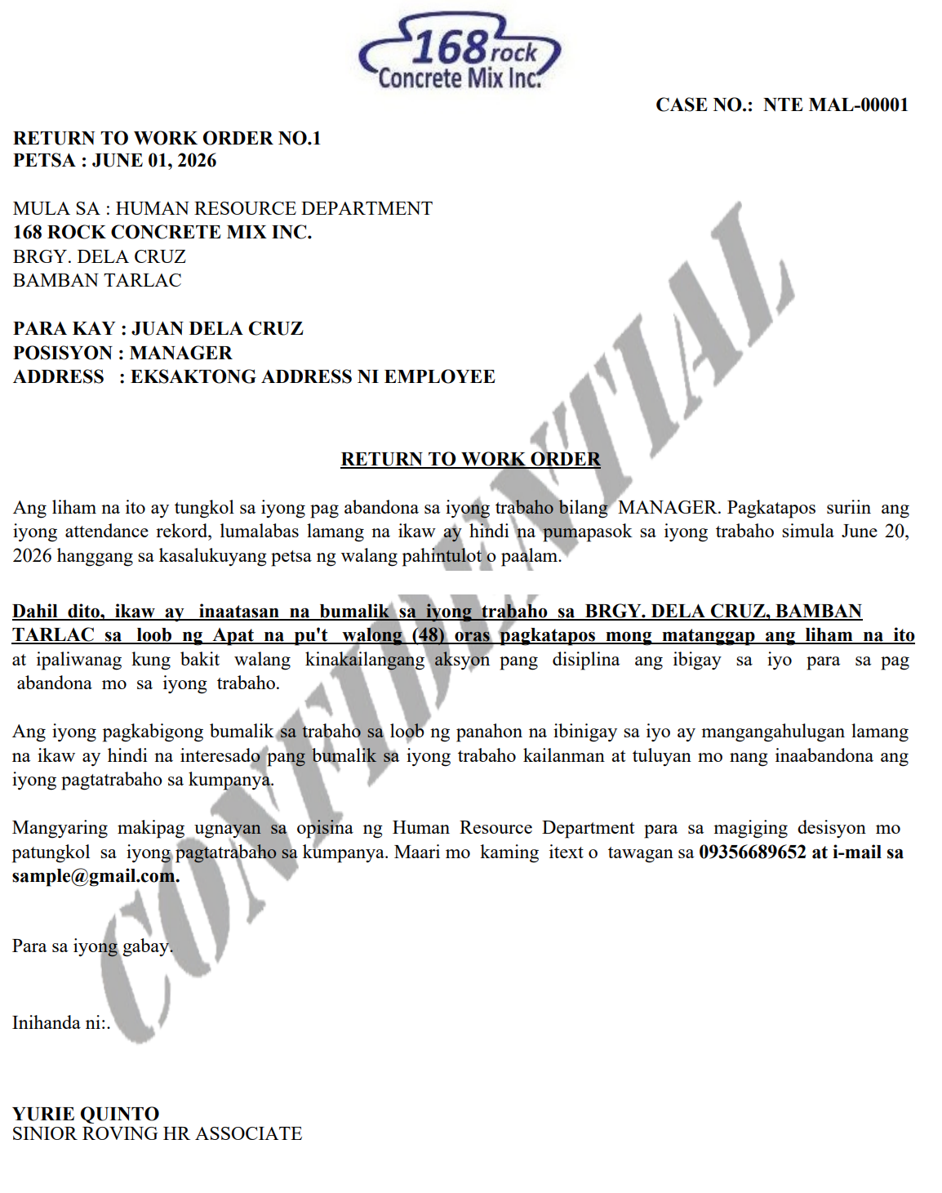
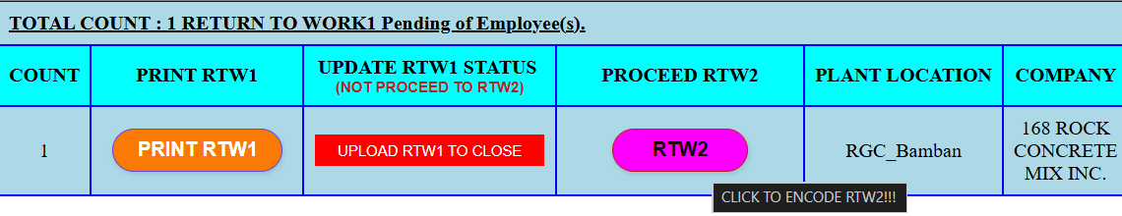
RTW2 (Return To Work2)
Click “PRINT RTW1” to view the RTW1 letter PDF file as shown on the screen.
This acts as a final warning, often combined with a Notice to Explain (NTE), to formally declare the employee is on Absence Without Official Leave (AWOL) and to determine if they have abandoned their job.
RTW2 can only shown on the RTW1 open screen. Based on common HR practices, Return to Work (RTW2) is typically issued as a follow-up action when an employee fails to respond to the first Return to Work Order (RTW1) within a specified time-frame, which can often be around 48 hours.
Toggle mouse/cursor to the RTW2
=> RTW2
“UPLOAD RTW1 STATUS” = When an employee resumes work after receiving a Return to Work1 (RTW1) order, the unauthorized absences (AWOL) are addressed.

Slide 9
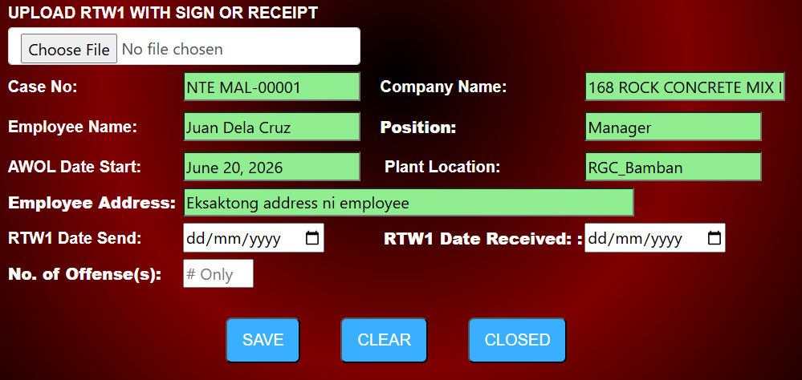
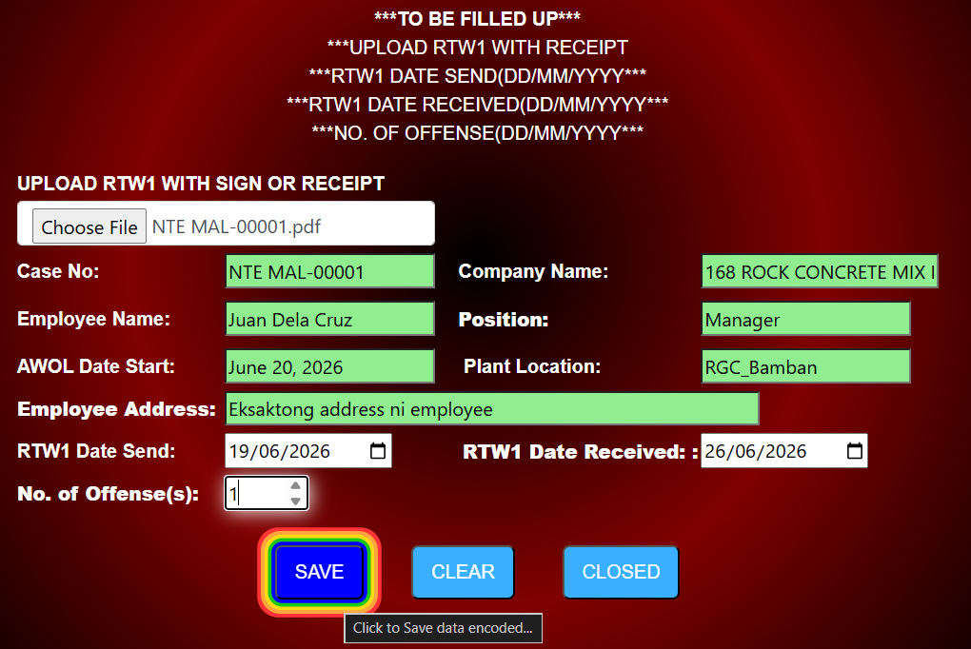
When clicking the RTW2 option, the system automatically pulls and displays all information previously entered in the RTW1 window.
While much of the information is prepopulated, the following fields must be filled by the user in the RTW2 window before saving or submission:
·UPLOAD RTW1: File with RTW1, Receipt & IR
·RTW1 DATE SEND: The date the RTW1 information was transmitted.
·RTW1 DATE RECEIVED: The date the RTW1 information was received by the handler.
·NO. OF OFFENSE: The number of offenses, incidents, or incidents relevant to this entry.
Always review the encoded data to ensure all data is correctly populated before finalizing, and saving. After ensuring all required fields are correctly completed, the data is saved by selecting the "SAVE" button. After the save button is clicked, the case number of RTW1 will transfer to RTW1 Closed.
Note: Due to Case Number is not changeable, please seperate the folder for RTW1, RTW2 & Notice of Termination for quick identification.

Slide 10
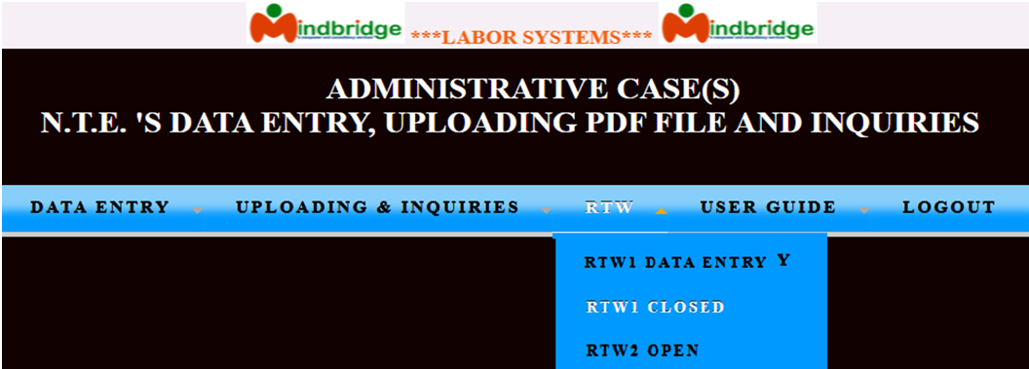
RTW1 CLOSED
Toggle mouse/cursor to the RTW
=> RTW1 CLOSED = Usually only becomes active after the user(s) encoded Return to Work 2 (RTW2) into the system. Just refresh the menu bar always. RTW1 remains active as long as there is an open case for RTW1. Once the RTW1 case is closed or there are no longer any open cases for it, the RTW1 status becomes inactive. Usually, RTW2 only becomes fully active in the system after the user encodes the Return to Work 2 (RTW2) data.

Slide 11
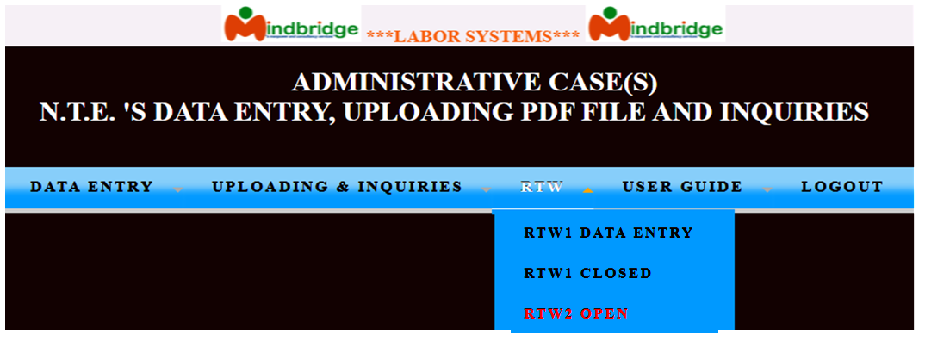
On selecting the “RTW1 CLOSED” option, all the information encoded will displayed / show on the window screen. Given below is a sample display of the RTW1 CLOSED control information window.
RTW2 OPEN
Toggle mouse/cursor to the RTW
=> RTW2 OPEN

Slide 12
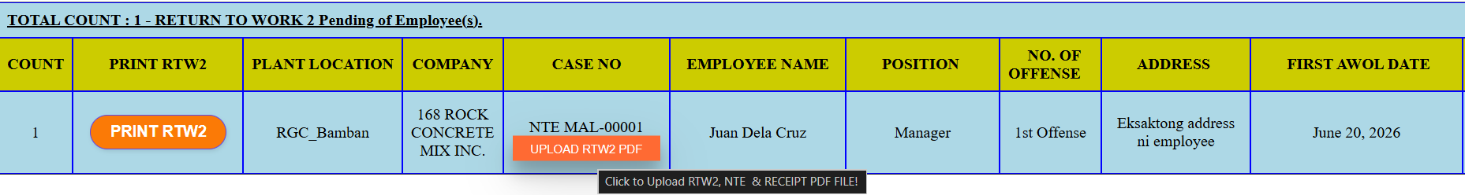
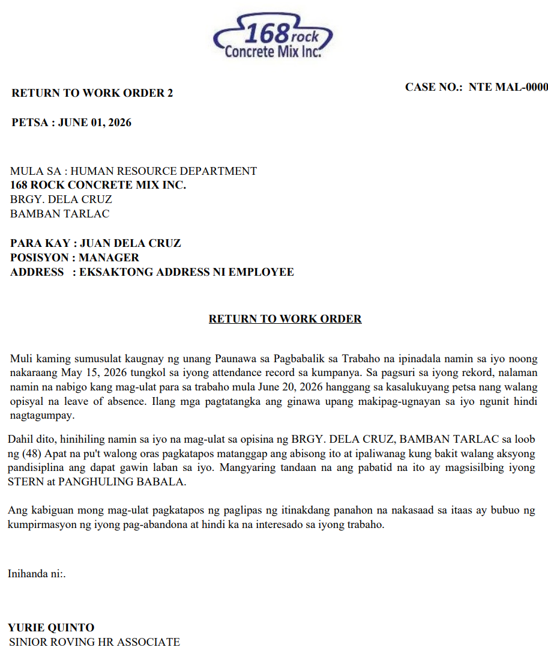
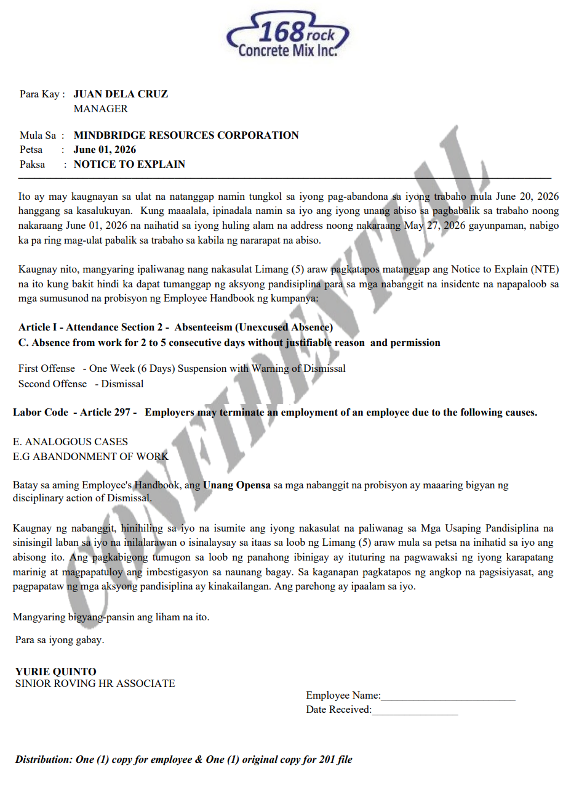
On selecting the “RTW2 OPEN” option, all the information encoded will displayed / show on the window screen. Given below is a sample display of the RTW2 OPEN control information window.
Click “PRINT RTW2” to view the RTW2 letter and Notice to Explain PDF file as shown on the screen below.

Slide 13
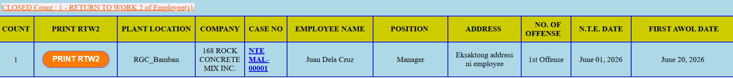
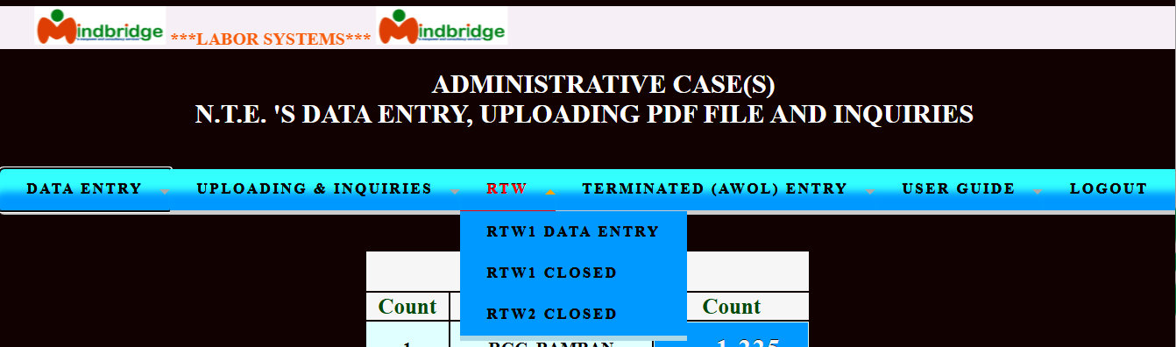
Cases of RTW2 OPEN can be closed only if the RTW2 & Receipt can be uploaded into the system.
Once the files are successfully processed and validated by the system, the status of RTW2 OPEN cases will update to CLOSED, as shown below.

Slide 14
TERMINATED (AWOL) ENTRY
A Notice of Termination is a 5 days pass without a reply or valid excuse, the employee is deemed to have waived their right to explain. The company issues a final written notice of termination (Notice of Decision) for job abandonment or gross neglect of duty.
* Accessing for TERMINATED EMPLOYEE -To access the TERMINATED EMPLOYEE section, go to the main window. Click on TERMINATED (AWOL) ENTRY menu bar, then choose the criteria appears as shown below. The Labor Systems (LS) user(s) can view only the criteria base on their user LOGIN.
Toggle mouse/cursor to the TERMINATED (AWOL) ENTRY
=> TERMINATED EMPLOYEE - Usually only becomes active after the user(s) uploaded the RTW2 and receipt.

Slide 15
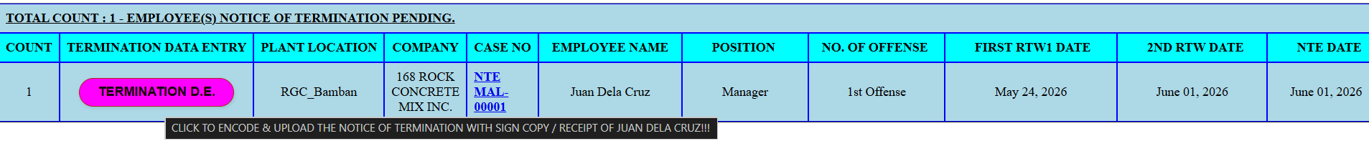
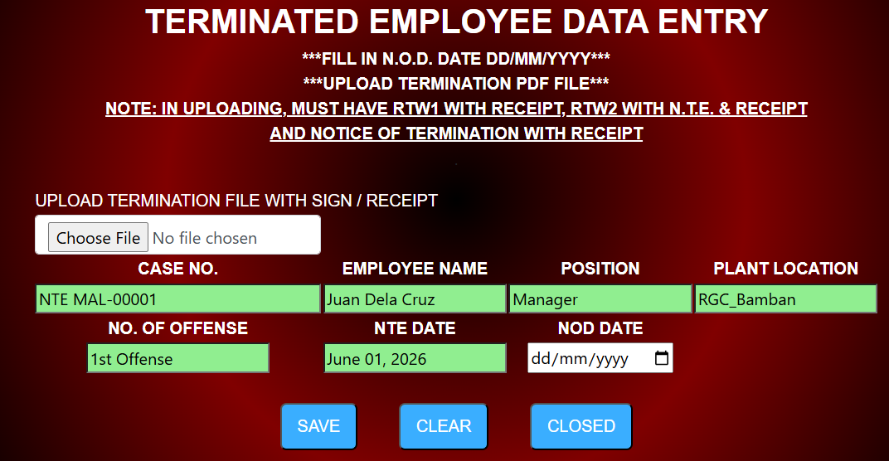
On selecting the “TERMINAED EMPLOYEE” option, all the information encoded will displayed / show on the window screen. Given below is a sample display of the TERMINATED EMPLOYEE control information window. Can be encoded only after sending the NOTICE OF TERMINATION into the subject employee for filing or restoring into the system porpuses.
When you click the TERMINATED D.E. (Data Entry) option, the system acts as an autofill and data recovery tool. It retrieves the historical records you previously logged in the RTW (Return to Work) module to ensure the separation process has full context. It automatically populates the termination profile so you don't have to retype employee. Just fill in the “UPLOAD TEMINATION FILE” and “NOD DATE” to compelte the termination data entry.
Note: Due to Case Number is not changeable, please seperate folder for RTW1, RTW2 & Notice of Termination for quick identification.
NOTE: In uploading Termination File, the PDF file must have RTW1 WITH RECEIPT, RTW2 WITH N.T.E. & RECEIPT and NOTICE OF TERMINATION WITH RECEIPT.

Slide 16
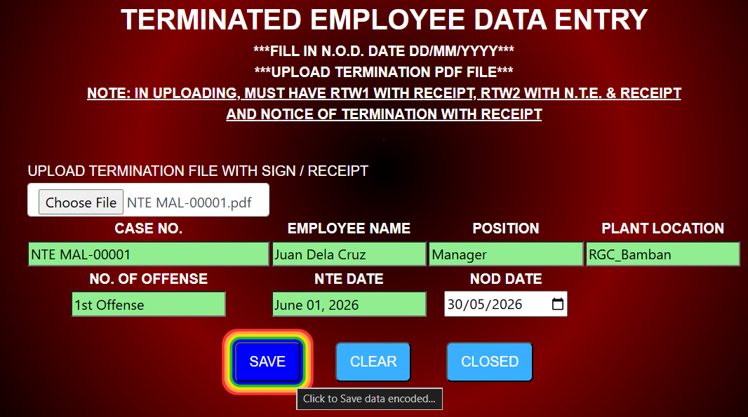
After ensuring all required fields are correctly completed, the data is saved by selecting the "SAVE" button.
All encoded Notice of Termination will be transfer and availabe in UPLOADING & INQUIRIES => TERMINATED EMPLOYEE.

Slide 17
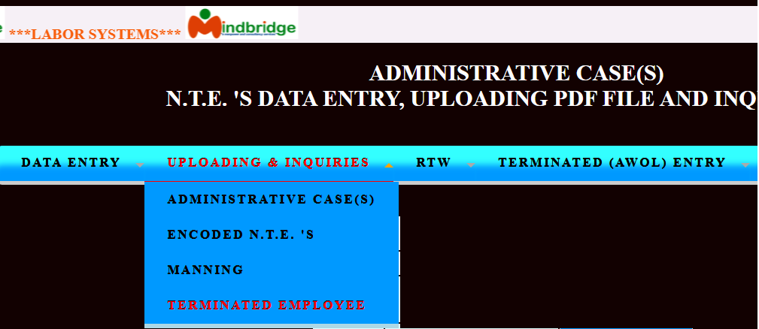
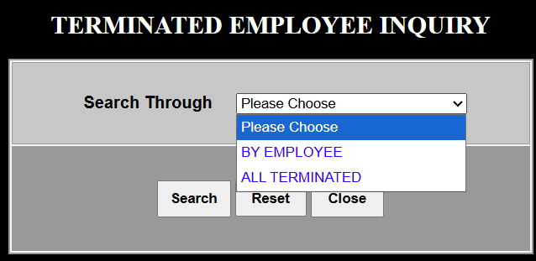
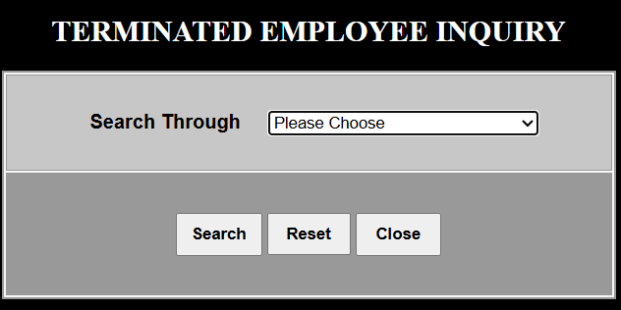
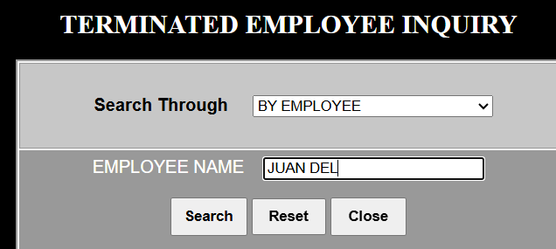
The user(s) will press the drop down box to choose which Search through to use in uploading & inquiries. The LS user(s) had an option to use Search Through: BY EMPLOYEE or ALL TERMINATED as shown below.
On selecting the “TERMINATED EMPLOYEE” option, the Information window is displayed. Given next window below is a sample display control information window.
By Employee

Slide 18

NOTED BY: RON JAN DALE G. ATIENZA
POSITION : HR-EMPLOYEE & LABOR RELATIONS OFFICER
DEVELOPED BY: CHERRY ESCLEO-CODILLA
POSITION : LABOR SYSTEM ADMINISTRATOR

